Slide 1
Introduction to Elements, Compounds and Mixtures

Slide 2
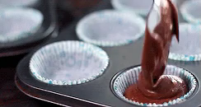
By the end of this Smart Lesson, you will be able to:
1. Define the terms pure substance and mixture.
2. Distinguish between pure substances and mixtures.

Slide 3
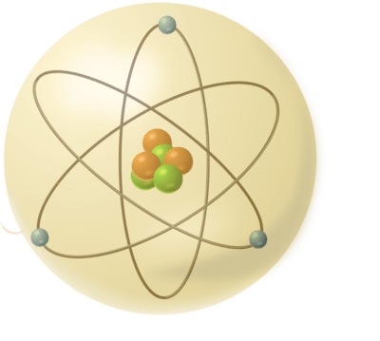
Before we start, let's have a look at a couple of terms that we will be using a lot in this module.
All substances are made of matter and matter gives all substances mass.
When we talk about matter in this lesson, we are talking about atoms.

Slide 4
All matter is made up of atoms.
Atoms are the basic building blocks of matter. There are many different kinds (over 100), and every piece of matter is made up of a combination of many atoms. Atoms bond together in different ways to produce different substances.
They are also very tiny - a single atom is usually around ten million times smaller than a millimetre.

Slide 5
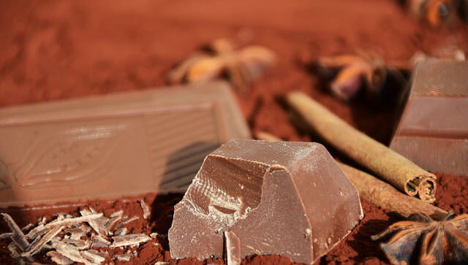
Let's have a look at some chocolate.
Don't eat it just yet, I know it's tempting. Just look at it. It seems so smooth and even, like it couldn't possibly be made up of a bunch of different things. But that's exactly what it is.
If we look at the list of ingredients in Dairy Milk chocolate, we can see it contains milk, sugar, cocoa butter, cocoa mass, milk solids, emulsifiers, and flavours.

Slide 6
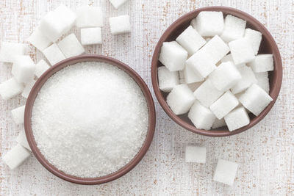
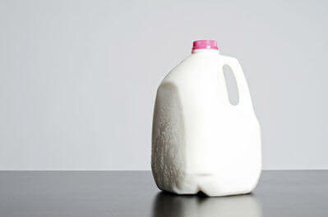
Chocolate and the substances that make it up are all varieties of matter.
Matter can be split into two groups: pure substances and mixtures.
A substance is a mixture when its particles are not all the same. Milk, sugar and cocoa particles are all different, so chocolate is a mixture.

Slide 7
A substance is pure when all of its particles are the same.
For example, sugar is a pure substance. Sugar is entirely made up of sugar particles. It has no other substances in it.

Slide 8
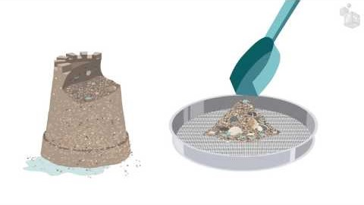
This video (1:05) explains the difference between mixtures and pure substances.

Slide 9
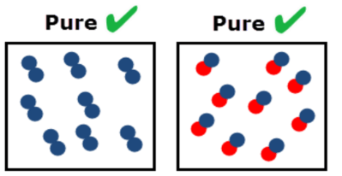
Pure substances are materials that are only composed of one type of particle.

Slide 10
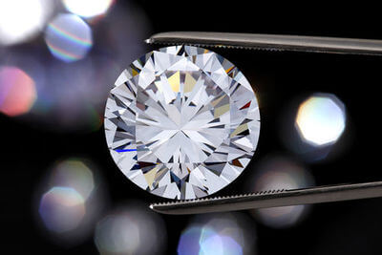
A pure substance is a substance that cannot be separated by physical means, like filtration or evaporation.
Examples of pure substances include water, gold, sugar, carbon dioxide, oxygen and diamonds.
A pure substance is made up of one type of particle. The particle that makes up diamonds is carbon, called C. The particle that makes up sugar is more complicated - it is called sucrose.

Slide 11
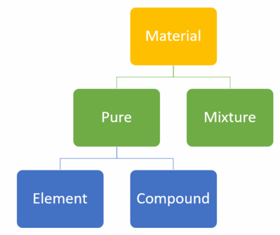
Pure substances can exist as either elements or compounds.

Slide 12
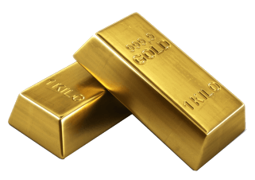
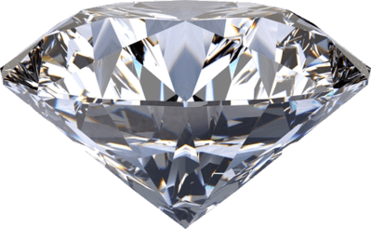
An element can only be made up of the same type of atoms.
Gold only contains gold atoms. Silver will only contain silver atoms and diamonds will only contain carbon atoms.

Slide 13
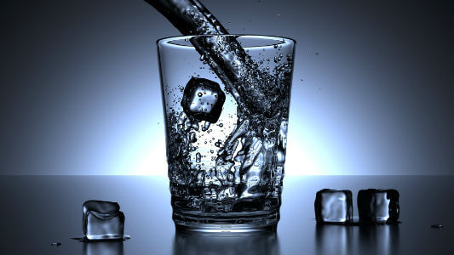
A compound is composed of two or more different types of atom.
For example, water is made up of hydrogen and oxygen atoms bound together by strong chemical bonds. A glass of water contains billions of these water particles.

Slide 14
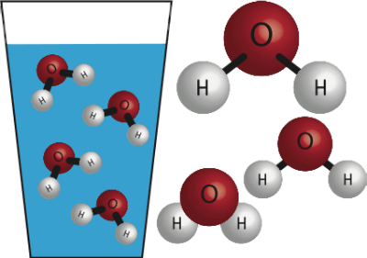
Both elements and compounds can be pure substances.
A pure substance contains elements or compounds that are all the same.
Compounds can be considered pure substances because, although there are different atoms in the compound, the entire substance contains the same compound.

Slide 15
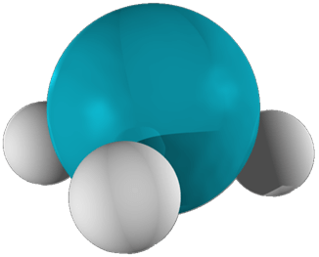
Another example of a pure substance made of a compound would be a bottle of ammonia gas.
Ammonia is a compound made of one nitrogen atom and three hydrogen atoms: NH3​. Since every molecule in the bottle would be an ammonia molecule, this is a pure substance.

Slide 16
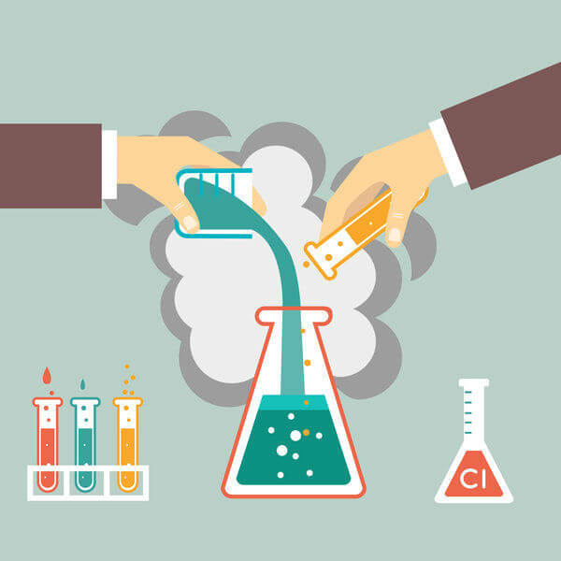
Mixtures contain two or more types of particles that are only combined physically.
This means that their atoms are not bonded together.

Slide 17
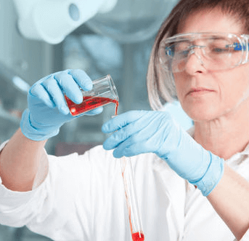
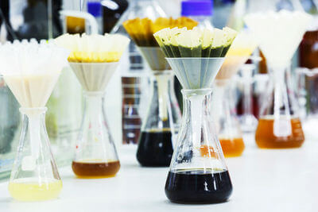
Mixtures can be separated into pure substances using physical methods, such as filtration and decanting.
Filtration is used to separate bigger particles from smaller particles. Decanting is used to separate heavier liquids from lighter liquids.

Slide 18

Mixtures can be made of elements, compounds or both.
⋅ | Air is mostly a mixture of nitrogen and oxygen, both elements.
⋅ | Lemonade is a mixture of water, sugar and various other compounds.
⋅ | A mixture of sand and iron filings is composed of elemental iron and compounds such as silicon dioxide.

